Slide 1
An Empirical Study of a Large-Scale Agile Transformation of an Online Retailer
Melisa Uluer, 02.12.2019, Kick-Off Bachelor’s Thesis

Slide 2
Agenda
Motivation
Research on Large-Scale Agile Transformations
Industry partner
Research Questions
Initial findings
Timeline

Slide 3


Motivation
Digitalization confronts organizations with multiple challenges:
customer demands
Increasing market dynamics
Continuous emergence of novel advancements in IT
Requires organizations to rethink how to:
Interact with customers
Define value propositions
Leverage data
Organize internal operations
[6;8]
Notes:
-organizations are confronted with challenges by the omnipresent digital transformation
-requires organizations to rethink how they interact with customers, how they define value propositions, leverage data and organize internal operations.

Slide 4


Motivation
Digital transformation imposes the need to react to rapidly changing market demands
Agile methods enable faster response to changes in organizational environments
[6;8;13]
Notes:
Competitors develop new products and services using digital technologies
Thus…
One popular option to address this challenges is to introduce agile methods
agile methods promise higher quality in products and higher customer satisfaction by short iterations and continous delivery, active customer involvement, deals better with changing requirements

Slide 5

Motivation
Companies are increasingly adopting agile methods to become more flexible and adaptive
The ability to sense and to respond swiftly and flexibly to technical changes, new business opportunities and unexpected environmental changes
[3;7]
Notes:
Companies adapt the agile methods to their needs and not only are the methods applied by firms outside the IT and software industry but also employed beyond their traditional application areas like IT related projects and software development
Wider application areas allow an overarching implementation of agile methods within firms, which leads to the large-scale application of agile methods
- In order to succeed at the large-scale application, the organization’s processes, policies, and culture must all reflect agile values and basically develop an agile mindset
- Their goal is to become agile in the enterprise context which is defined as …
And the process to achieve this goal is called the agile transformation

Slide 6
Definition of Large-Scale Agile Transformation
“
Switch of an organization from a different development approach or work organization concept to the application of agile methods on an organizational level with multi-team settings that consist of 50 or more people or at least six teams
Definition of Large-Scale Agile Transformation
[3;5]
Notes:
Where the transformation can cover a one-time big bang transfer to agile methods or a stepwise approach where an agile pilot is subsequently scaled up into a large setting
Scaling up:
More organizational members employing agile methods
Extending the application of agile methods within the firm
Deepening the application of agile methods

Slide 7
Research on Large-Scale Agile Transformations
Challenges
Research gap
Success factors
Change resistance
Coordination challenges in multi-team environment
Hierarchical management and organizational boundaries
Need for empirical studies
Lack of understanding agility in the enterprise context
Lack of focus on the impact of the large-scale agile transformation
Ensuring management support
Training and coaching
Team autonomy
[1;3;5;6;11]
Notes:
- Large-scale agile transformations entail unprecedented challenges for organizations
There also some success factors for conducting large-scale agile transformations, e.g., ....
Goal of this thesis is to address the research gap.
But before moving on with my research questions, I will shortly introduce you to out collaboration partner

Slide 8

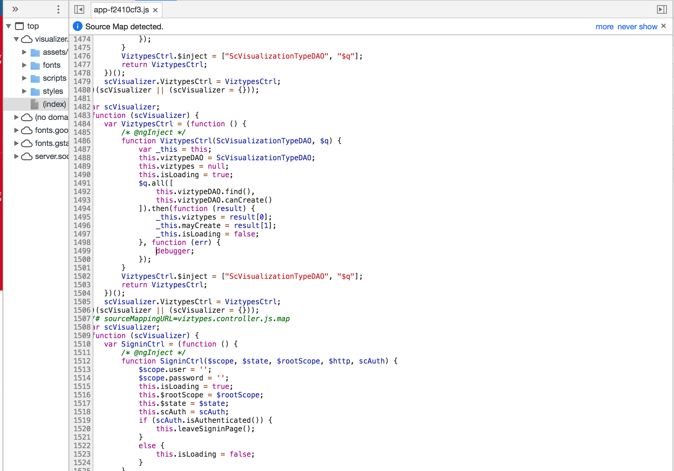
Industry partner
Industry partner
Online retailer for photo products in Germany
Subsidiary of the PhotoBox Group
Founded in 2004
Location and production in Munich
Currently approx. 200 employees
Agile Transformation started in 2015

Slide 9
Research Questions
What is the actual state regarding the large-scale agile transformation at PosterXXL?
RQ01
Which impact does the large-scale agile transformation at PosterXXL has on the organization?
RQ02
What are success factors and barriers of the large-scale agile transformation at PosterXXL?
RQ03
What are the lessons learned of the large-scale agile transformation at PosterXXL?
RQ04
Notes:
Identified research gap leads me to my resesrch questions….
All of them are answered by means of interviews

Slide 10
Research Question 1
What is the actual state regarding the large-scale agile transformation at PosterXXL?
RQ01
Total of 33 categories
Excerpt:
Management style | Team location | Project planning | Testing
Role Assignment | Team size | Documentation | Requirements
[2;4;10;12]
Notes:
In order to pursue the first research question, categories were identified on the basis of a literature review which enable the comparison of organizations according to these categories. -A total of 33 categories were identified
This is an excerpt from the categories

Slide 11
Research Question 1
What is the actual state regarding the large-scale agile transformation at PosterXXL?
RQ01
Total of 33 categories
Excerpt:
After coding
is completed
Command and
Control
Leadership
distributed
collocated
Up front
continuous
Every iteration
Management style | Team location | Project planning | Testing
Role Assignment | Team size | Documentation | Requirements
Individual –
favour
specialization
Self-organizing
teams –
encourages role
interchangeability
> 10
< 10
substantial
minimal
Very stable,
known in
advance
Emergent,
with rapid changes
[2;4;10;12]
Notes:
These categories can be split up into two contradicting dimensions as agile methods and plan-driven methods have a different focus
Meaning that the participants rate in a scale of 6 whether they are rather agile, agile or fully agile or rathe traditional, traditional or fully traditional
This is used to describe what the actual state is and to find out what the desired state is.
By doing this, the company can reflect critically by answering the questions what they have achieved so far and what they still want to do or whether the final status has already been achieved.
Furthermore, Agile Transformation is made comparable by categories.

Slide 12
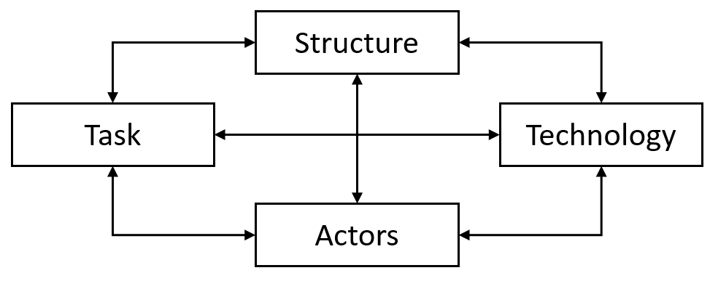
Research Question 2
Which impact does the large-scale agile transformation at PosterXXL has on the organization?
RQ02
Socio-technical model by [9]
Notes:
To pursue the second research question, we use the socio-technical systems theory.
-The theory distinguishes between two interacting systems in a company, the social system and the technical system. --The social system consists of the components persons and structure and the technical system of task and technologies.
-These components are interdependent, i.e. if a task changes, then all other components change as well.
-Theory is used as a guide to analyse changes.
-The idea is to describe the effects of transformation using these four dimensions.

Slide 13
Research Question 3&4
What are success factors and barriers of the large-scale agile transformation at PosterXXL?
RQ03
What are the lessons learned of the large-scale agile transformation at PosterXXL?
RQ04
Notes:
open questions that help to identify success factors, barriers and lessons learned in practice

Slide 14
Initial findings
Actual state
Assumed organization to be agile rather than traditional
Except „documentation“ categorie
Would remain the state or move further to „the optimum“
Impact
Technology:
  Could not say much about that
Structure:
  Polarizing
Actors:
  Motivation encouraged
  Group → team
Tasks:
  More flexible
  Identification of obsolete tasks
Notes:
Movining on with my first findings;
I will show you the findings of my first interview on the basis of my research questions

Slide 15
Initial findings
Lessons learned so far
Middle Management has to commit
Spotify Model did not work
Motivated teams lead to success
Success factors
  Clarification
  Listen and understand
  Just do it
Barriers
  Rejection Agile Team by employees and middle management
Notes:
Movining on with my first findings;
I will show you the findings of my first interview on the basis of my research questions

Slide 16



Timeline
Sep
Oct
Nov
Dec
Jan
Feb
Literature Review
Prepare and conduct Interviews
Data Analysis
Writing Bachelor’s Thesis
official start
15th September 2019
2nd December 2019
official end
15th February 2020
Notes:
Next steps:
Conducting interviews which are already scheduled
Starting as soon as possible with the data analysis
And finishing my thesis

Slide 17
Interviews
Conducted
3.12 – 6.12
9.12 – 13.12
January
Interview: 19.11.2019
2. Interview: 03.12.2019
3. Interview: 03.12.2019
4. Interview: 04.12.2019
5. Interview: 04.12.2019
6. Interview: 04.12.2019
7. Interview: 06.12.2019
8. – 14. Interview
15. – 17. Interview

Slide 18
References
[1] Abrar, Muhammad Faisal; Khan, Muhammad Sohail; Ali, Sikandar; Ali, Umar; Majeed, Muhammad Faran; Ali, Amjad et al. (2019): Motivators for Large-Scale Agile Adoption From Management Perspective: A Systematic Literature Review. In: IEEE Access 7, S. 22660–22674. DOI: 10.1109/ACCESS.2019.2896212.
[2] Conboy, Kieran; Coyle, Sharon; Wang, Xiaofeng; Pikkarainen, Minna (2011): People over Process: Key Challenges in Agile Development. In: IEEE Softw. 28 (4), S. 48–57. DOI: 10.1109/MS.2010.132.
[3] Dikert, Kim; Paasivaara, Maria; Lassenius, Casper (2016): Challenges and success factors for large-scale agile transformations: A systematic literature review. In: Journal of Systems and Software (119), S. 87–108. DOI: 10.1016/j.jss.2016.06.013.
[4] Dingsøyr, Torgeir; Moe, Nils Brede; Fægri, Tor Erlend; Seim, Eva Amdahl (2018): Exploring software development at the very large-scale: a revelatory case study and research agenda for agile method adaptation. In: Empir Software Eng 23 (1), S. 490–520. DOI: 10.1007/s10664-017-9524-2.
[5] Fuchs, Christoph; Hess, Thomas: Becoming Agile in the Digital Transformation (2018): The Process of a Large-Scale Agile Transformation.

Slide 19
References
[6] Gerster, Daniel; Dremel, Christian; Kelker, Prashant (2018): "Agile Meets Non-Agile": Implications of Adopting Agile Practices at Enterprises.
[7] Hekkala, R., Stein, M.-K., Rossi, M., and Smolander, K. (2017). "Challenges in Transitioning to an Agile Way of Working," Proceedings of the 50th Hawaii International Conference on System Sciences, Hawaii, USA.
[8] Joehnk, J., Röglinger, M., Thimmel, M., and Urbach, N. (2017). "How to Implement Agile IT Setups: A Taxonomy of Design Options," in: Proceedings of the 24th Eurpean Conference on Information Systems (ECIS). Guimaraes, Portugal.
[9] Leavitt, Harold J. (1965): Applied Organizational Change in Industry: Structural, Technological and Humanistic Approaches. In: Handbook of Organizations, S. 1144–1170.
[10] Nerur, Sridhar; Mahapatra, RadhaKanta; Mangalaraj, George (2005): Challenges of migrating to agile methodologies. In: Commun. ACM 48 (5), S. 72–78. DOI: 10.1145/1060710.1060712.
[11] Paasivaara, Maria; Behm, Benjamin; Lassenius, Casper; Hallikainen, Minna (2018): Large-scale agile transformation at Ericsson: a case study. In: Empir Software Eng 23 (5), S. 2550–2596. DOI: 10.1007/s10664-017-9555-8.

Slide 20
References
[12] STOICA, Marian; MIRCEA, Marinela; GHILIC-MICU, Bogdan (2013): Software Development: Agile vs. Traditional. In: IE 17 (4/2013), S. 64–76. DOI: 10.12948/issn14531305/17.4.2013.06.
[13] Torgeir Dingsøyr, Sridhar Nerur, VenuGopal Balijepally, and Nils Brede Moe. “A decade of agile methodologies: Towards explaining agile software development”. In: Journal of Systems and Software 85.6 (2012), pp. 1213–1221

Slide 21
Melisa Uluer
17132
melisa.uluer@tum.de

Slide 22
BACKUP SLIDES

Slide 23
Research Approach - Interviews
5-10 min
20 min
30 min
15 min
Introduction
Identifying actual state
Identifying impact
Identifying success factors & barriers
Identifying lessons learned

